Slide 1

MeetYOU A Cloud Based Meeting Application
Shawon Barman (18201043)
Ferdous Alam Nayeem (18201035)
Jasmine Akter (18201044)
Sanjida Shifa (17101101)

Slide 2
OUTLINE
What Is Our Project About?
Motivations
Problem Definition
Objective
Importance
Related Existing Platform
Limitation of previous work
Our Proposed Solution
Legal Issues
Health And Safety Issues
Development Tools
Project Planning

Slide 3
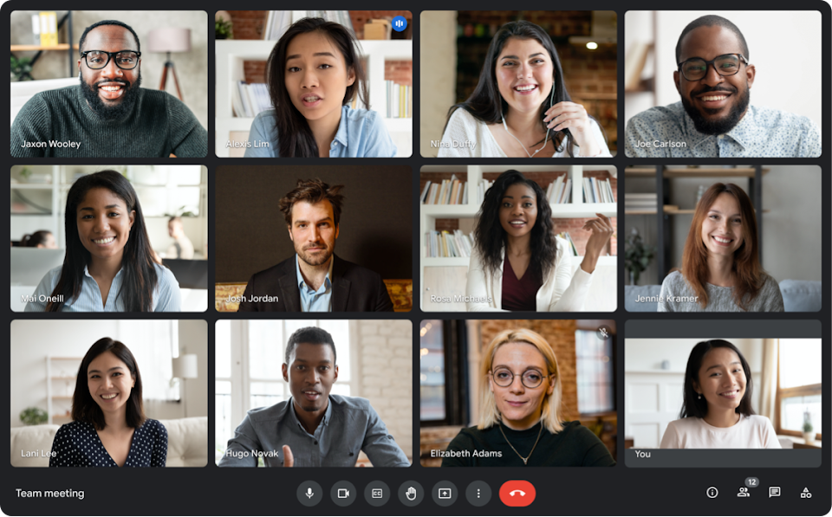
What is Our Project About?
In this project,
we will build a Cloud based Meeting Application using webRTC and socket.io and JavaScript framework react, that will work as an online web application to support the work of real life classroom, conference rooms, meetings, etc.

Slide 4
Motivation
In a situation during the Covid-19 pandemic, this type of web application is very helpful to proceed with all the work that would otherwise be difficult to be carried out with the facilities provided by social media.
There is no online platform which offers unlimited meeting with duration with free of cost.
Notes:
Some of the motivations that inspired us to choose this topic are

Slide 5
Problem Definition
In a situation during the Covid-19 pandemic, a video conferencing web application is helpful to proceed with all the work that would otherwise be difficult to be carried out with the facilities provided by social media. There is no online platform which offers unlimited meetings with duration free of cost
To solve this problem, our platform can be used. Our cloud based Meeting Application MeetYOU will help users to conduct class, conference rooms, meetings virtually without any limitations
Notes:
Some of the motivations that inspired us to choose this topic are

Slide 6
Objective
The objective of our cloud based Meeting Application MeetYOU will help users to conduct class, conference rooms, meetings virtually without any limitations.
Notes:
Some of the motivations that inspired us to choose this topic are

Slide 7
Importance
Seamless Communication between users.
Lower total costs: Although the system is free for use to everyone, it will reduce cost.
Geographic Flexibility: It relates to flexibility involves prospective students' geographic location.
Pacing Options: Synchronous online session maintain set meeting times.

Slide 8
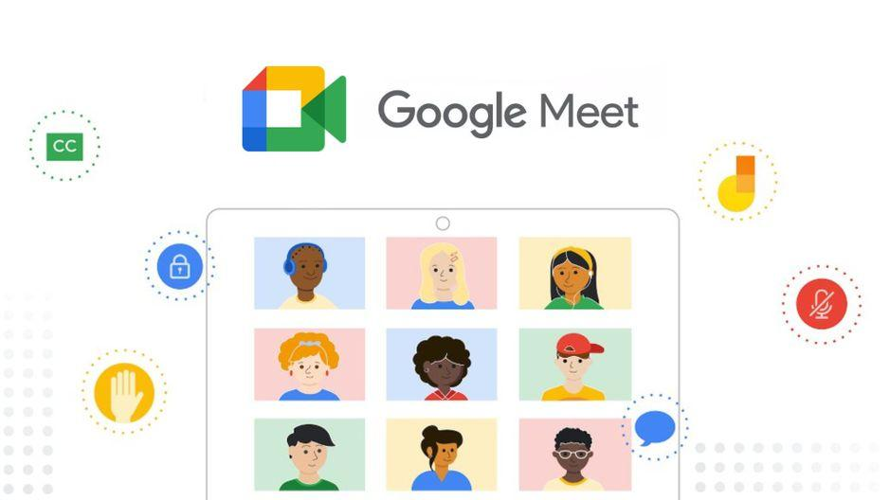
Related Existing Platforms
Google Meet
Google Meet is a video-communication service developed by Google.
Features:
Real time video conferencing
Screen sharing with participants
Messaging with participants
Controls for meeting hosts

Slide 9

Related Existing Platforms
Zoom
Zoom Cloud Meetings is a video conferencing and web meeting app developed by Zoom Video Communications.
Features:
HD Video Conferencing
Cross-Platform Messaging
Meeting Recordings
File Sharing

Slide 10
Limitation Of Previous Work
Most of cloud-based meeting application are not completely free.
There are some limitation on existing meeting platform. Examples:
Limited time meeting duration
Limited number of participants
Required their own service accounts
No Full HD streaming

Slide 11

Our Proposed Solution
A complete free open-source meeting app
Unlimited number of meetings
Unlimited duration
Compatible across devices
Video and audio preview screen
Controls for meeting hosts
Screen sharing with participants
Messaging with participants
Instant file sharing with participants
Full HD screen sharing supported
And More.

Slide 12

Legal Issues
We will ensure data privacy of our every user, only authorized users can access his own data, no data from our web application will be leaked or sold to third party applications.
We will develop our application according to Digital Security Laws of Bangladesh. So, our cloud meeting application will be completely legal for anyone to use freely.

Slide 13
Health and Safety Issues
In covid or any other pandemic situation, By using our platform peoples can communicate with others and still can maintain social distance.
We are using WebRTC end-to-end encryption between each user. So it will ensure each users privacy.

Slide 14










Development Tools
Languages
Framework
Database
IDE
Version Control

Slide 15
Project Planning
Task | Time Duration
Project Selection | 1st And 2nd Week
Presentation on project proposal | 3rd Week
UML design | 4th Week
User interface design | 5th Week and 6th Week
Database and Front End implementation | 7th Week and 8th Week
Backed development And Testing | 9th,10th , 11th and 12th Week
Final Presentation | 13th Week
Report Writing | 14th Week

Slide 16
How Ks are addressed through the project and mapping among Ks, COs, and POs
Ks | Attribute | How Ks are addressed through the project | COs | POs
K3 | Engineering Fundamentals | This project requires knowledge of WebRTC and good understanding of concepts of React framework. Knowledge of Programming languages (JavaScript, HTML,CSS), Load Balancing are also required | CO4 | POf
K4 | Engineering Specialist Knowledge | On this proposed system there will be a webbased frontend and integration of different components in backend. Which will be great engineering practices for this system. | CO5 | POh
K5 | Engineering Design | Here we are using modern engineering design to identify and solve the problem with a powerful and more efficient approach. | CO8 | POk
K7 | The Role Of Engineering In Society | This project helps a lot of users to conduct their meeting virtually. Which has a large impact on society. People can use our platform remotely and get their job done. It can also help to maintain social distance and continue their work during any pandemic like covid 19. | CO10 | POa
K8 | Research literature | Our project requires study of existing models with similar goals such as a similar online video-based meeting platform like google meet, zoom etc. we have identified and analyzed all the features in those meeting platform and tried to implement all those features on our project. | CO1 | POb

Slide 17
How Ps are addressed through the project and mapping among Ps, COs, and POs
Ps | Attribute | How Ps are addressed through the project | COs | POs
P1 | Depth of Knowledge Requirement | Our project requires a extensive amount of research and study of all existing video conferencing web platforms (K8), conduct and analysis survey on stakeholders – users, development team (K3,K4), On this proposed system there will be a web-based front-end and integration of different components in back-end. (K5,K6). | CO1 CO4 CO5 CO8 CO10 | POb POf POh POk POa
P2 | Range of Conflicting Requirement | Quality of video streaming can be conflicting reason if server runs out of resources. | CO1 CO2 | POb POc
P3 | Depth of Analysis Required | A dedicated monitoring authority is needed to ensure user satisfaction. they will also ensure to improve the platform continuously according to user’s recommendation and feedback. | CO1 CO3 CO5 CO8 | POb POf POh POk
P4 | Familiarity of Issues | There is no completely free online meeting platform with unlimited duration. our project has the ability to solve this problem. Online meeting platform is also very helpful for remote work during any pandemic like Covid-19. | CO9 | PO1
P7 | Interdependence | Our project has interdependent components such as requirement analysis, user interface designing, frontend and backend development, load balancing, software testing, security testing, bug debugging etc. | CO8 | POk

Slide 18
Project - Github Repository
MeetYOU - A Cloud Based Meeting Application
https://github.com/ShawonBarman/MeetYOU-A_Cloud_Based_Meeting_Application

Slide 19
THANK YOU

